Slide 1











ctrl

Slide 2

Spring Cloud
Touch the Sky!
Fábio Falavinha

Slide 3

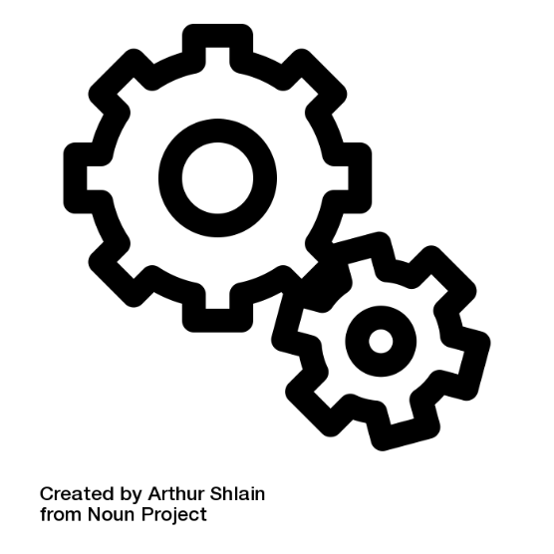
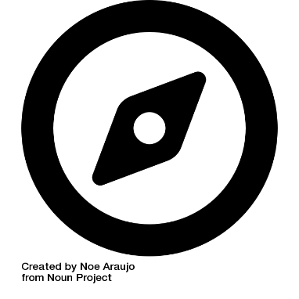
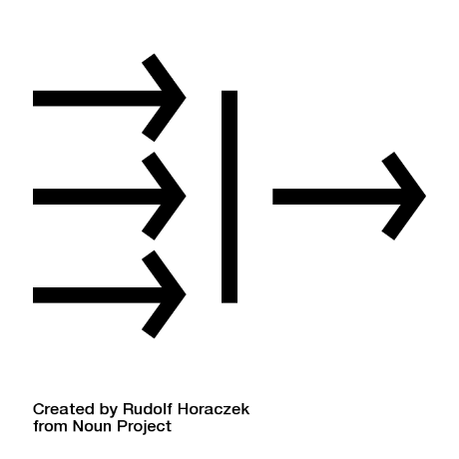
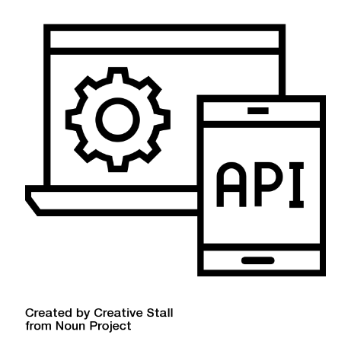

Service Discovery /
Client Load Balance
HATEOAS
Config Server
It's a design pattern enabling navigation into your Rest's Controllers and
it’s already free with Spring Data Rest
Refresh scope for dynamic re-configuration and
it’s already part of Spring Cloud Config Server
DNS could be a problem and
you can avoid that using
Netflix Eureka and Ribbon
Microproxy
API Gateway
Circuit Breaker
Enable proxy to guard your application
Use Zuul
Filtering and transforming data
to what your client needs.
For that use Feign
Open and Close concepts to handle
all interaction to your service.
Handling faults with fallback methods!

Slide 4
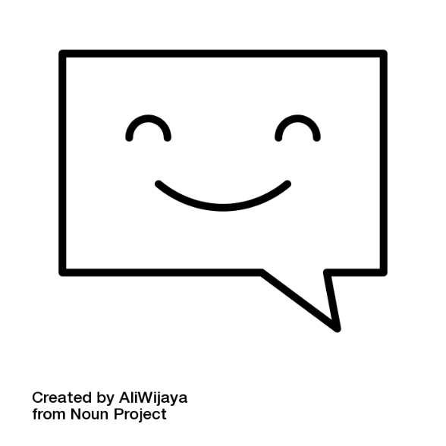
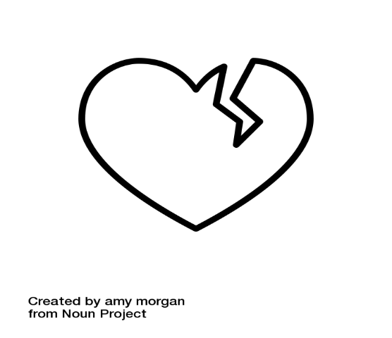
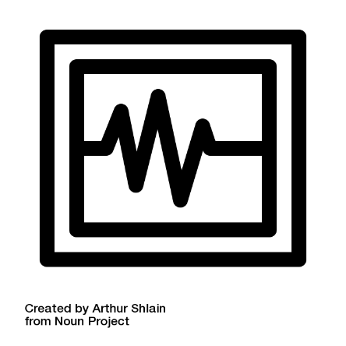
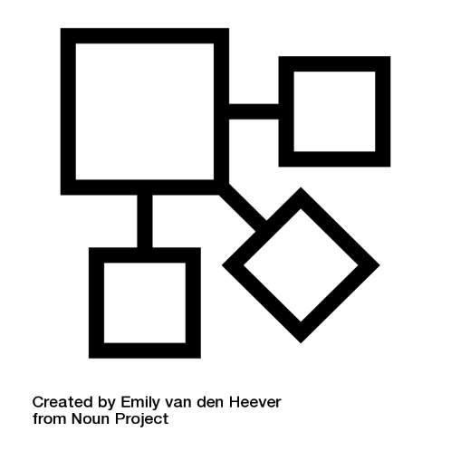
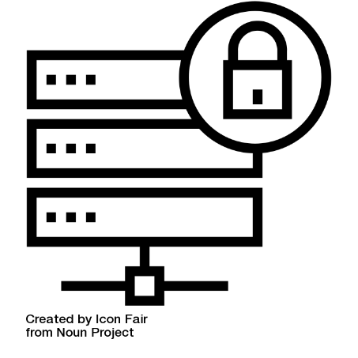
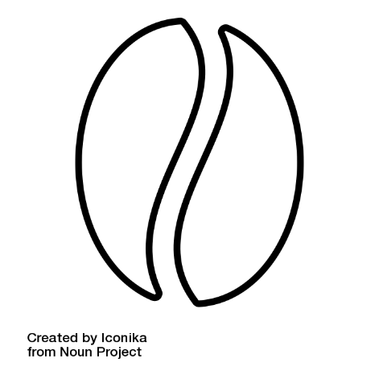
Messaging
SAGA Pattern
Monitoring
Integrate with other services using
Spring Integration,
Spring Cloud Stream and Rabbit MQ
Monitor all traffic that your service
will handle using Netflix Hystrix
and Spring Cloud Turbine
Is a failure management pattern
If use Distributed Transactions just GO HOME and comeback in the next day and review your idea… Use Apache Kafka (Distributed Streaming Platform)
Distributive Tracing
Security
The Real Service
Track all data inside of your solution
using Spring Sleuth and Spring Zipkin
Secure your service with Spring Security
Your service
You can use Spring Cloud Data Flow to create a flow messages to your service

Slide 5
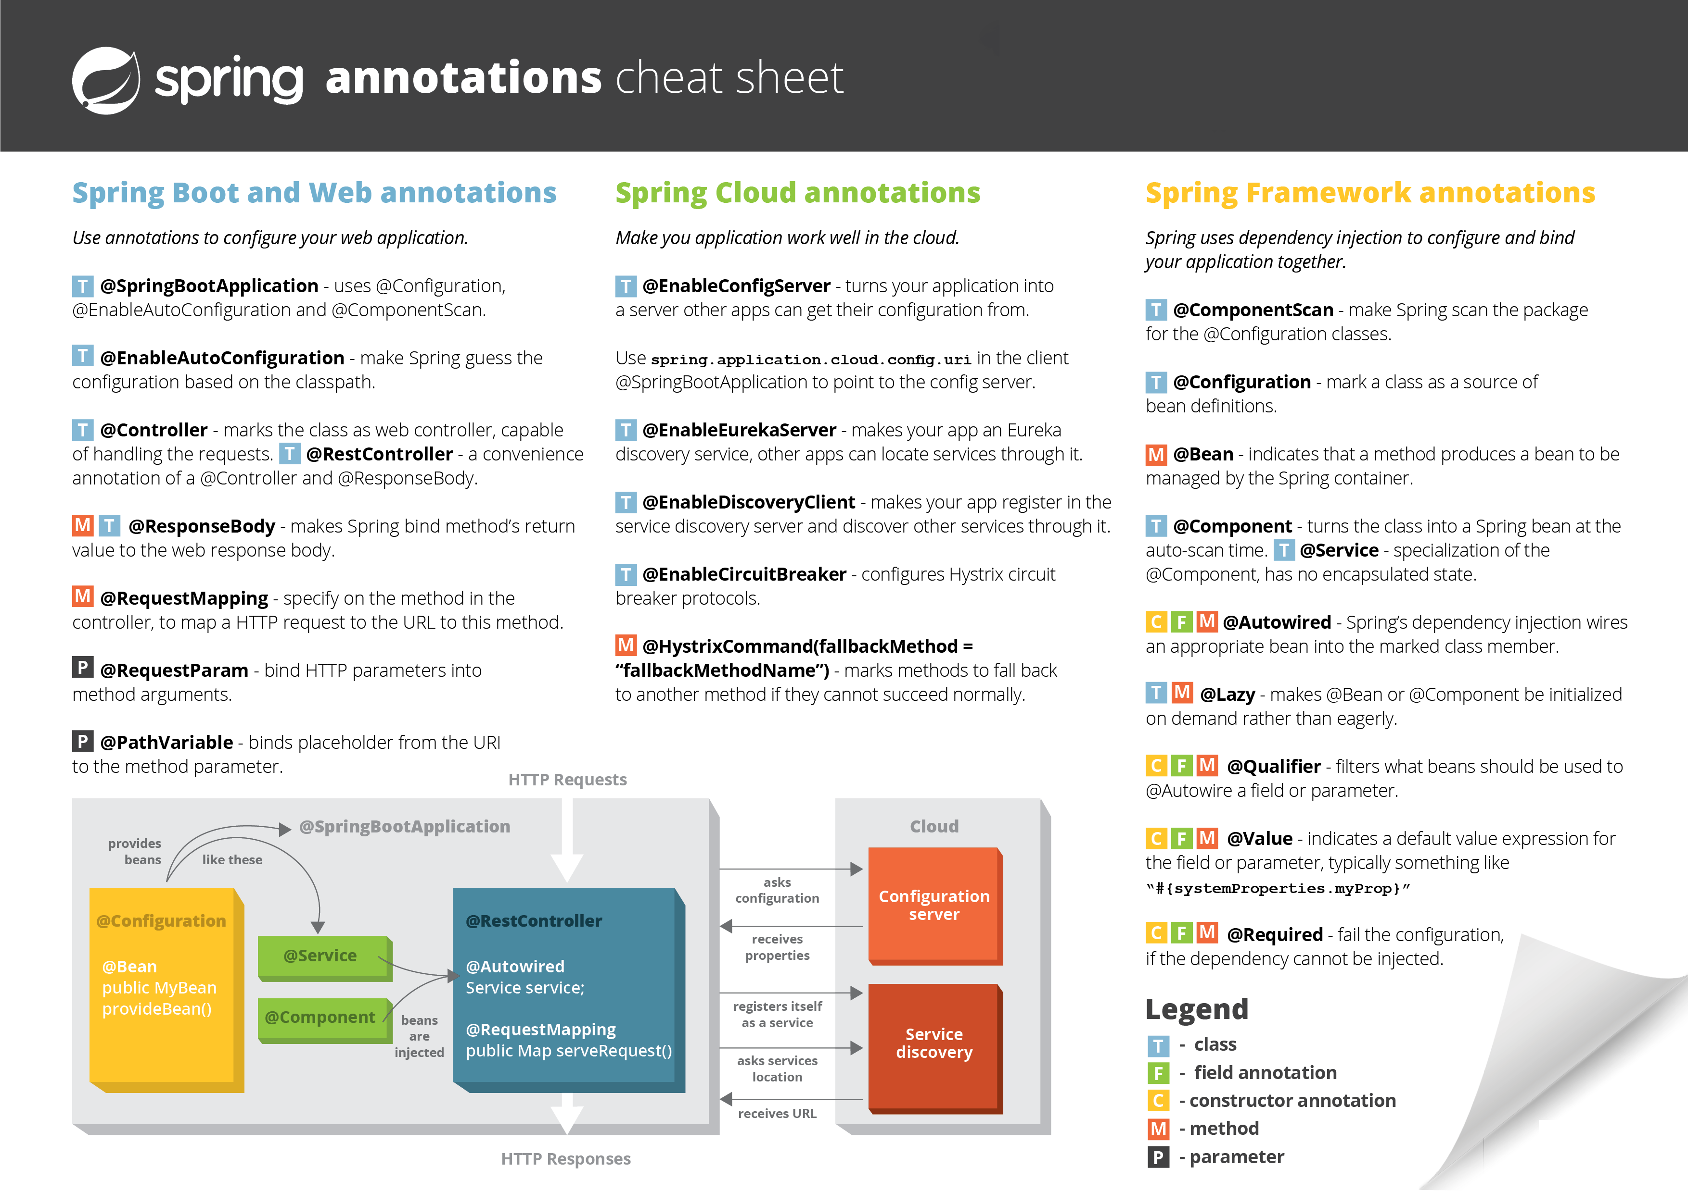

Slide 6
References
Spring Cloud
projects.spring.io/spring-cloud/
SAGA Pattern medium.com/@roman01la/confusion-about-saga-pattern-bbaac56e622
Spring Netflix Eureka
cloud.spring.io/spring-cloud-netflix/
Spring Netflix Ribbon
github.com/Netflix/ribbon
Spring Circuit Breaker (Netflix Hystrix)
spring.io/guides/gs/circuit-breaker/
Spring Sleuth
github.com/spring-cloud/spring-cloud-sleuth
Spring Turbine
github.com/spring-cloud-samples/turbine
Spring Security (I think Sergio loves this topic)
projects.spring.io/spring-security/
Apache Kafka
kafka.apache.org

Slide 7
Spring Cloud
Touch the Sky!
Thanks a lot! ☺

